Slide 1
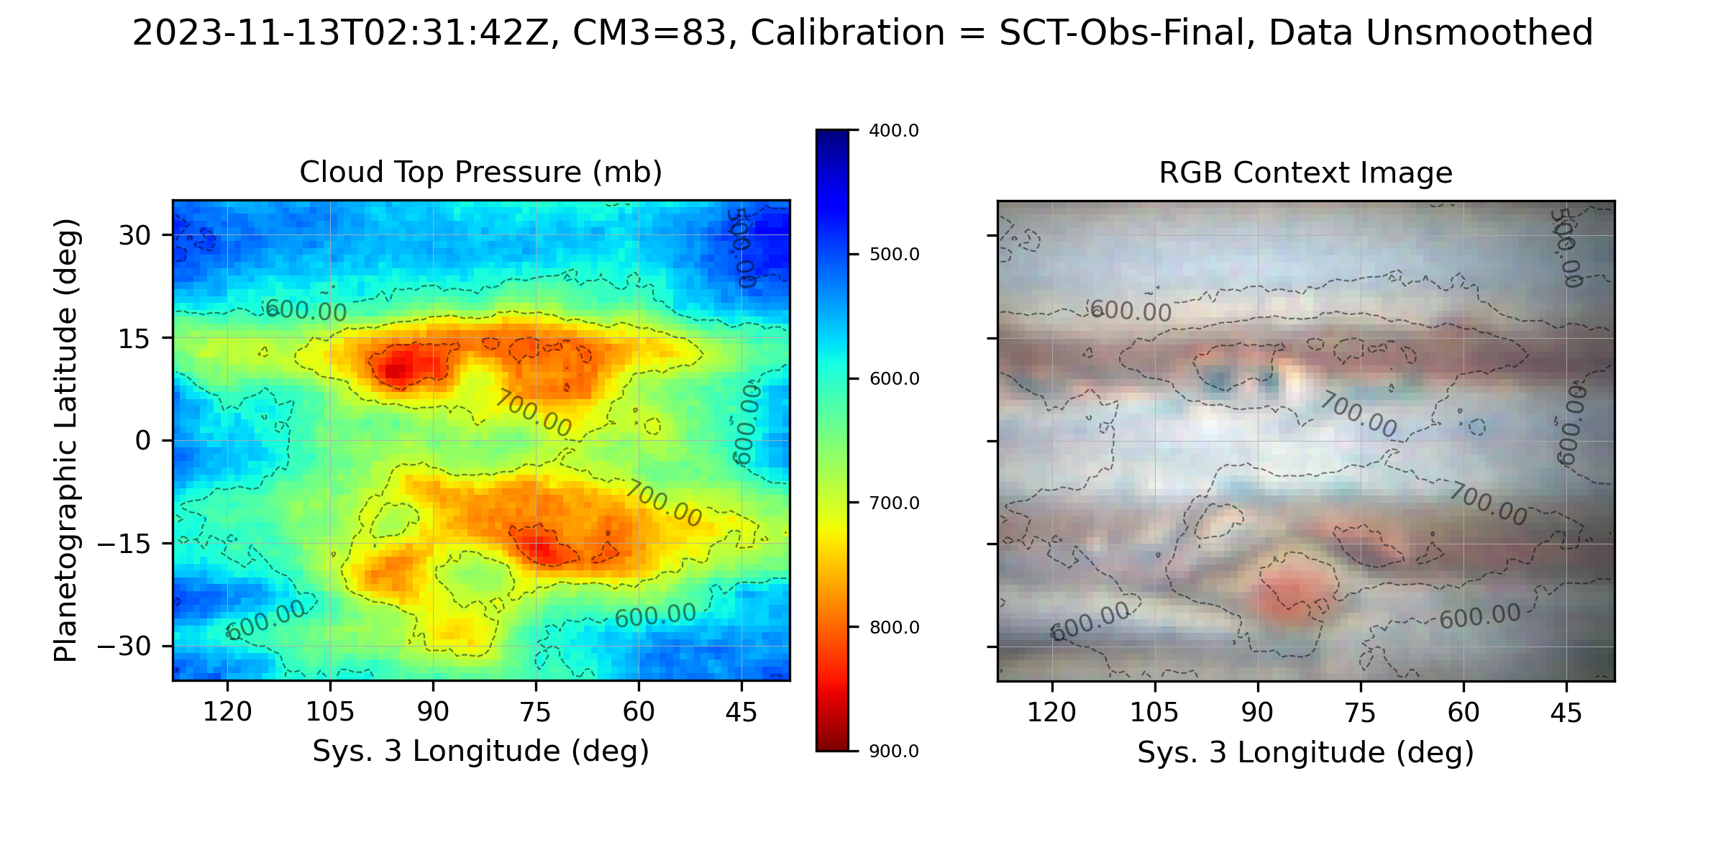
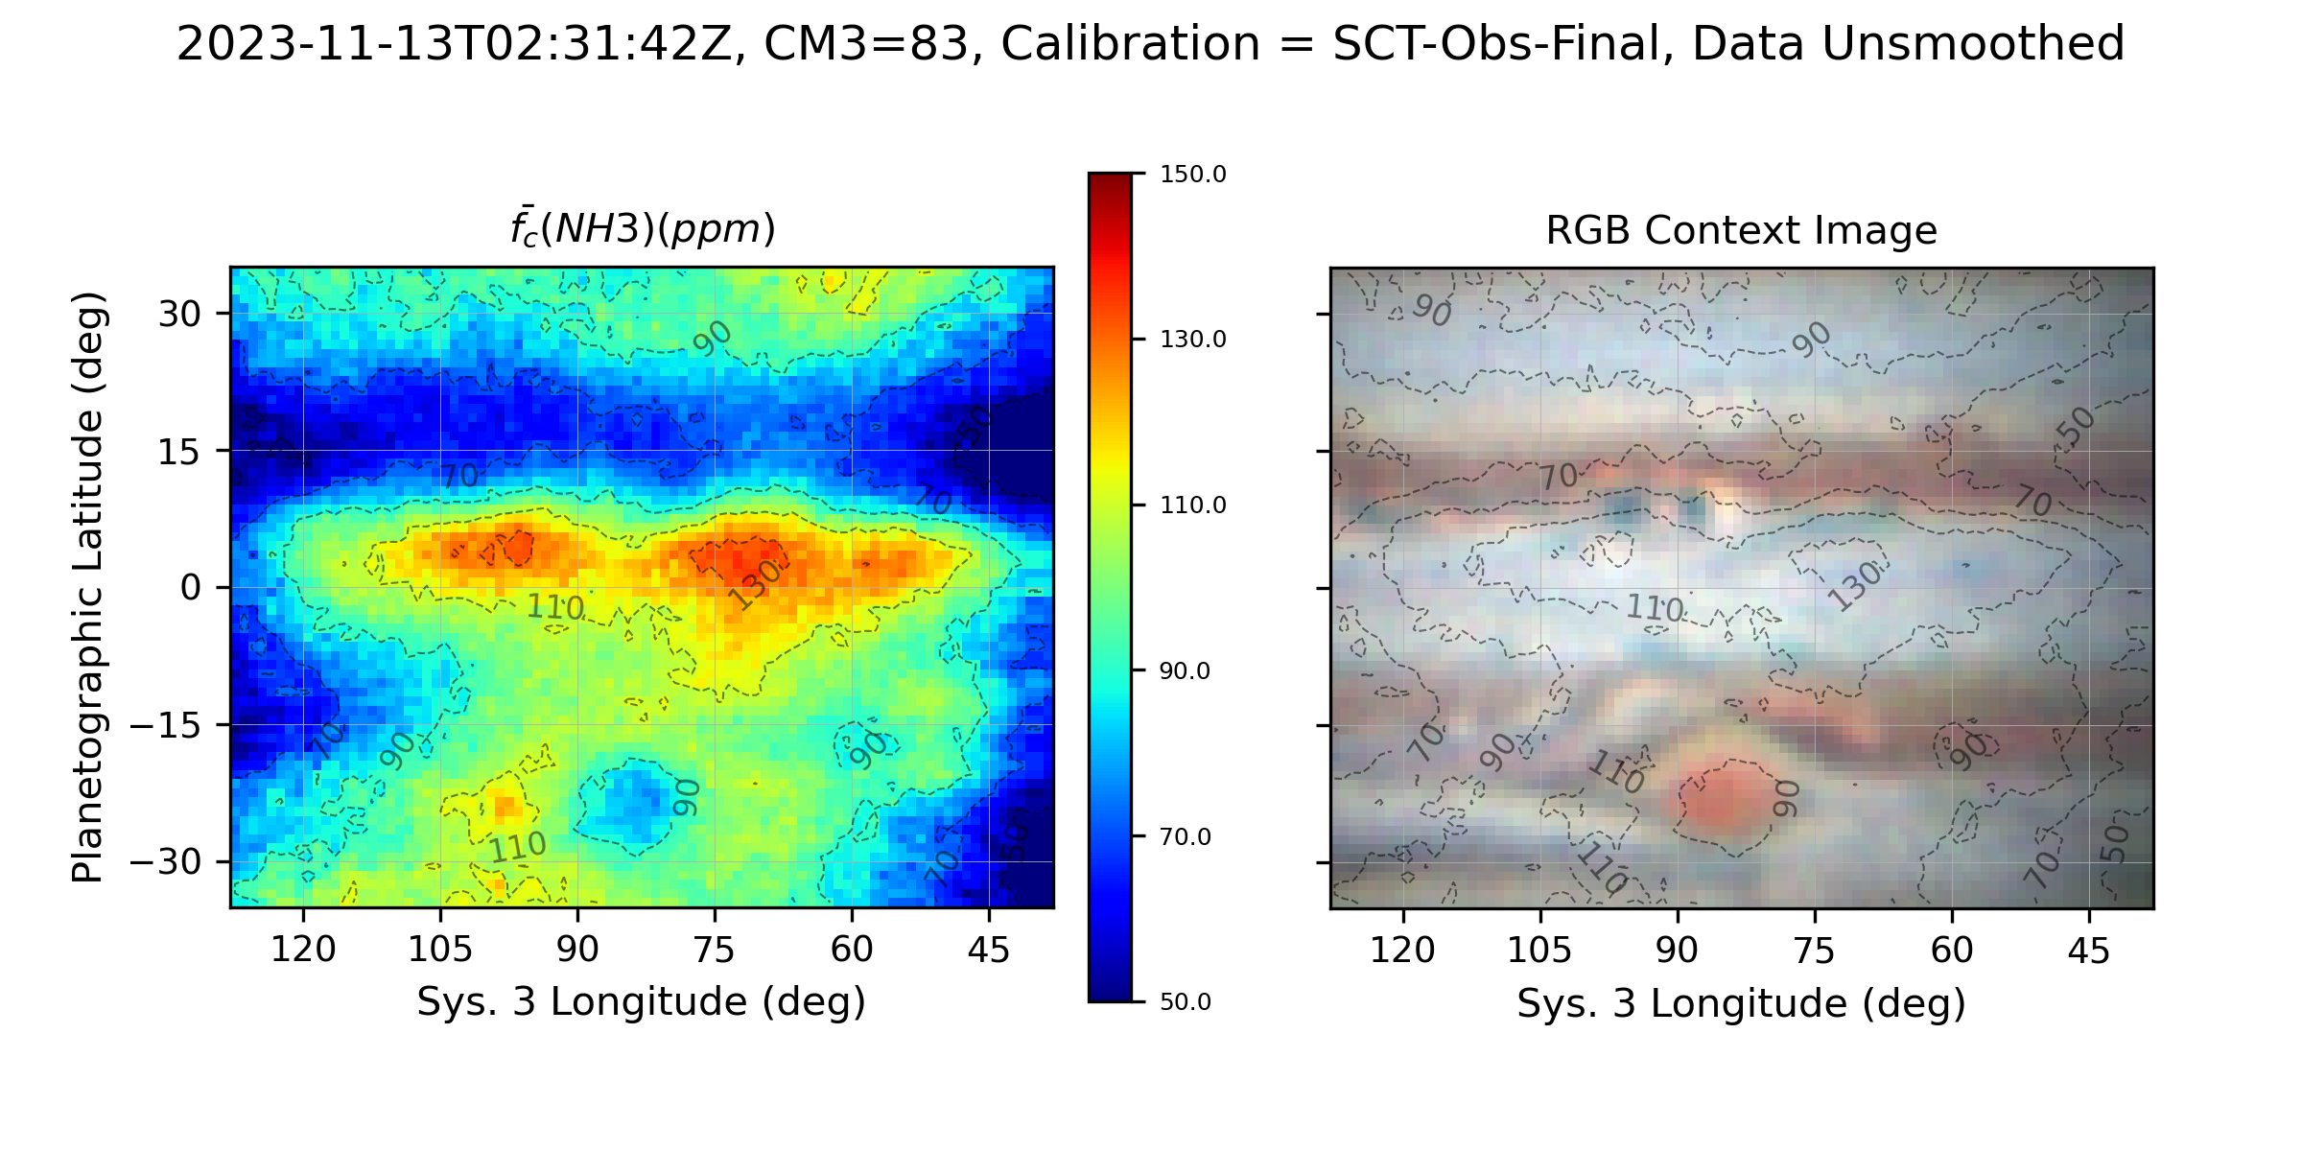
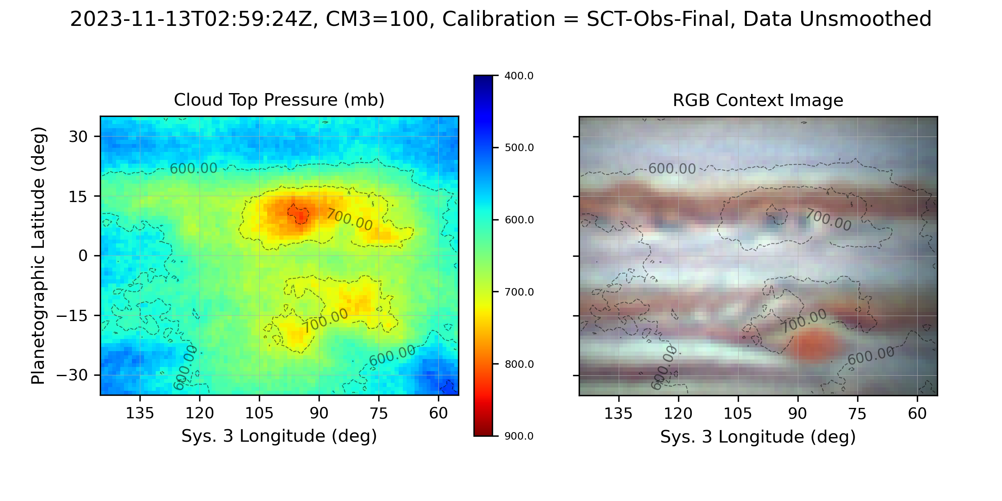
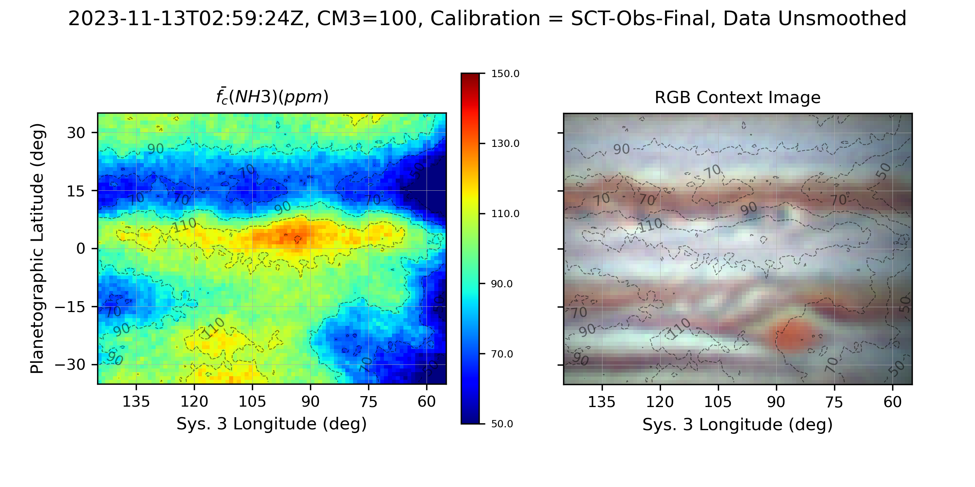
Effective Cloud Top Pressure (620 nm)
Ammonia Mole Fraction, f(NH3) (ppm)

Slide 2
NEZ ‘Population’ study of NH₃, CH₄ (619 nm), & WINJupos dark projections & festoons
Hypothesis: Plumes and dark formations (presumably 5-micron hot spots) represent a source-sink pair for gaseous NH₃.
NH₃ enhancements and CH₄ ‘deep clouds’ from current analysis analyzed for:
Location relative to each other: NH₃ enhancements appear distributed around a centroid ~3.5 deg S of dark formations, generally the same longitude.
Deep cloud locations match very closely with WinJUPOS dark projections & festoon locations.
Distribution of relative locations compared to flow diagram around ‘hot spots’ (Choi et al., 2013).
Individual examples of NH₃ distribution relative to deeper clouds associated with dark formations.

Slide 3
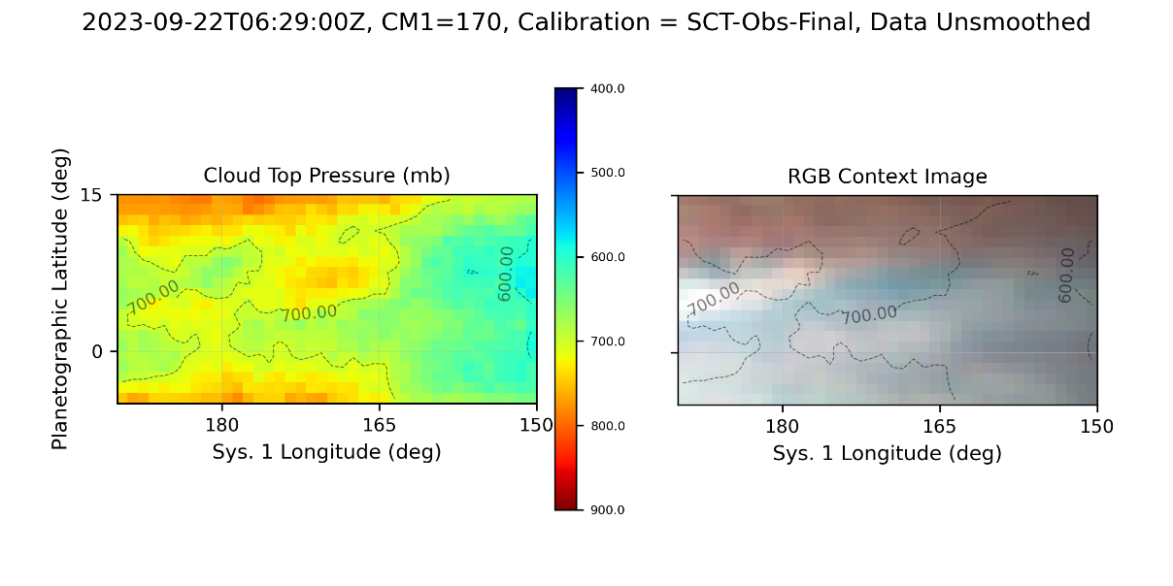
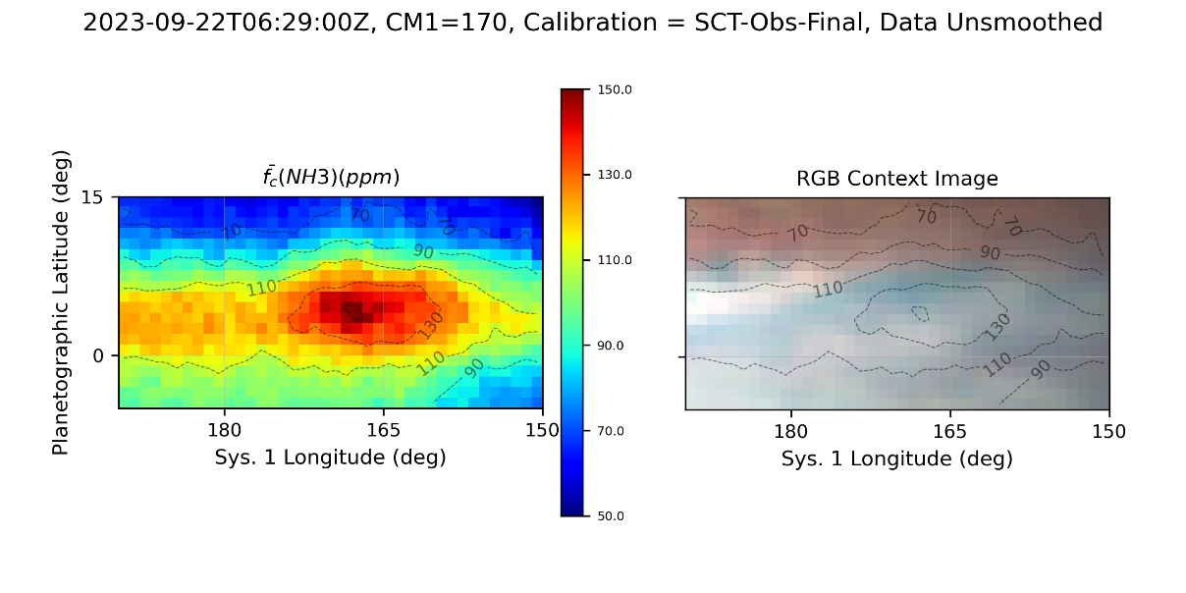
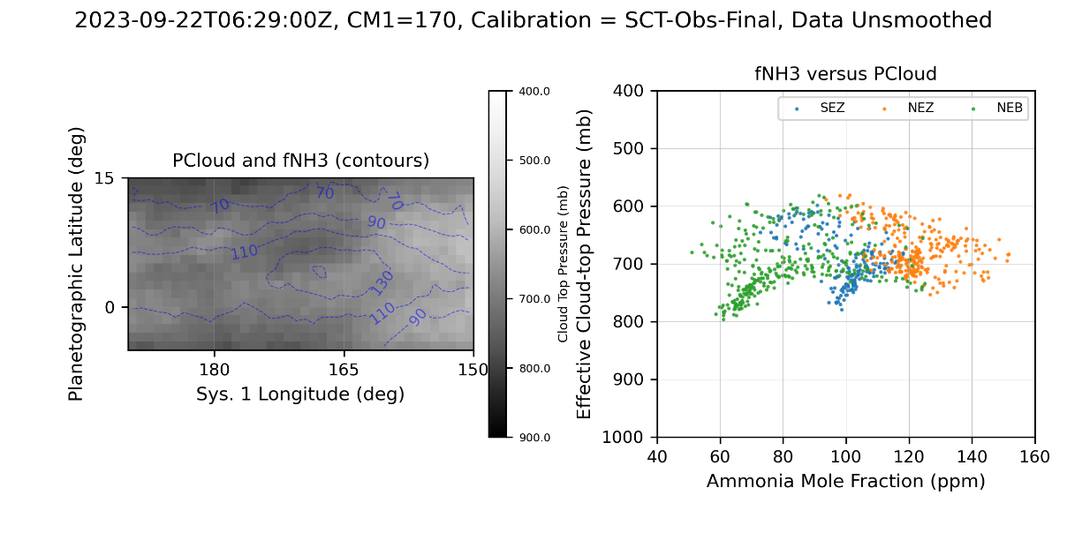
NH₃ enhancements and CH₄ Deep Clouds
a)
Effective cloud top pressure determined by CH₄ absorption. Contours show cloud top pressure overlaid on a contemporaneous optical context image.
Ammonia column-averaged abundance derived from the ratio of ammonia to methane absorption images. Contours show cloud top pressure overlaid on a contemporaneous optical context image.
Left: Effective cloud-top pressure rendered as grey scale with ammonia abundance contours. Right: Scatter plot of effective cloud-top pressure versus ammonia mole fraction by latitude band.
b)
Sixty-six NH₃ and CH₄ observations through 2023-11-28
2022: 18 with SCT, 2 with VLT
2023 45 with SCT
145 CH4 cloud holes / deep clouds
146 NH3 enhanced regions
Dark Projections & Festoons from WinJUPOS
Total 7082 positions between 2022-06-01 and 2023-11-22
c)

Slide 4
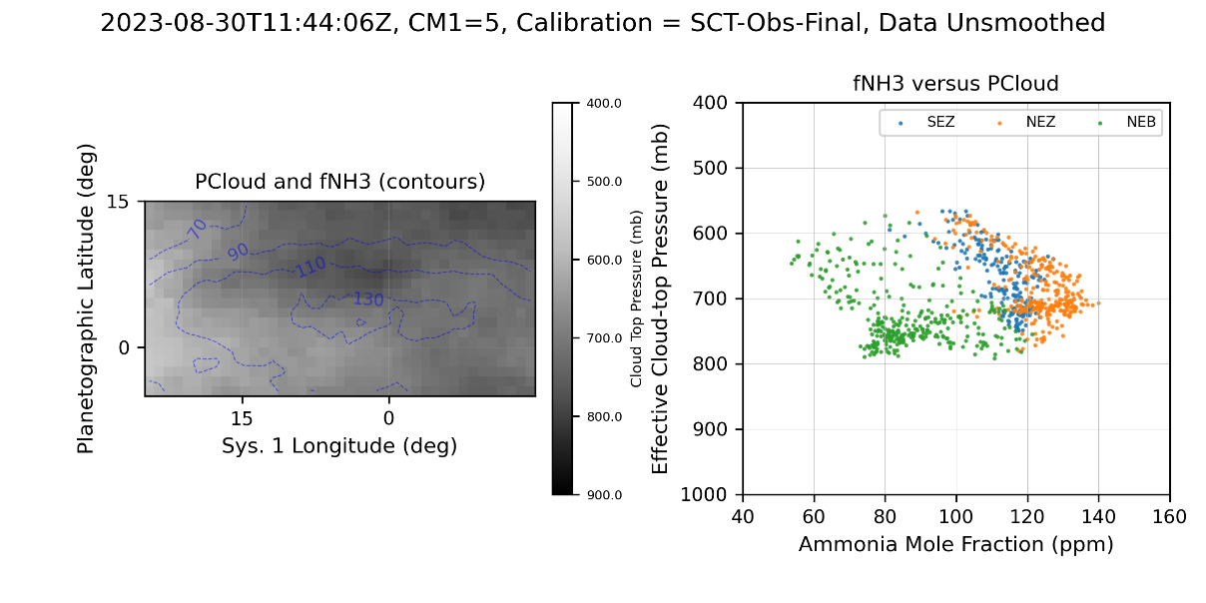
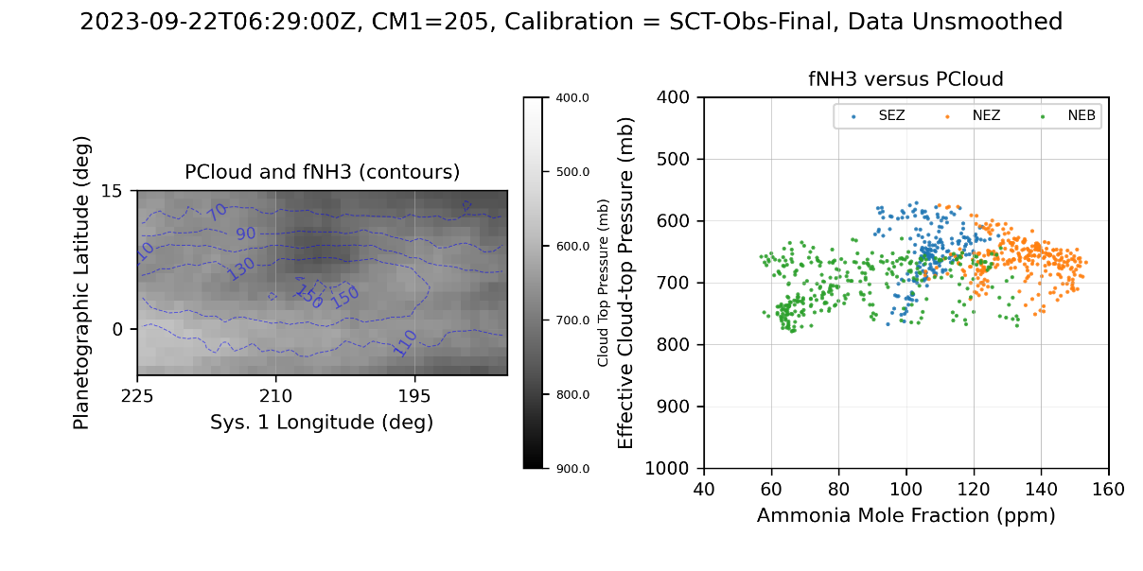
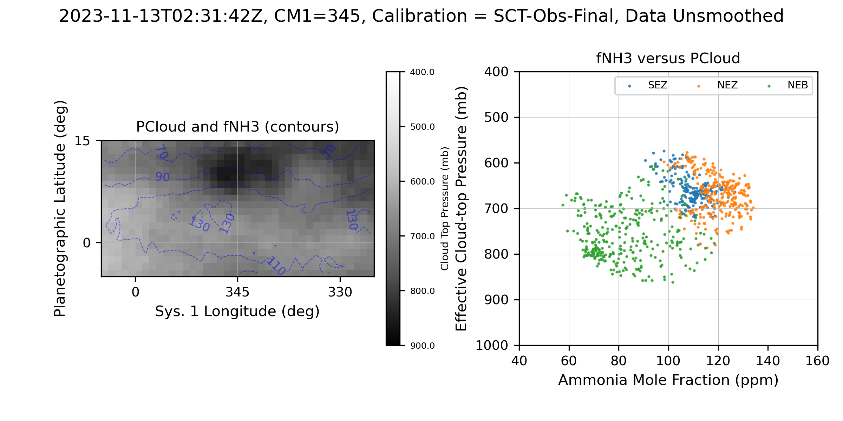
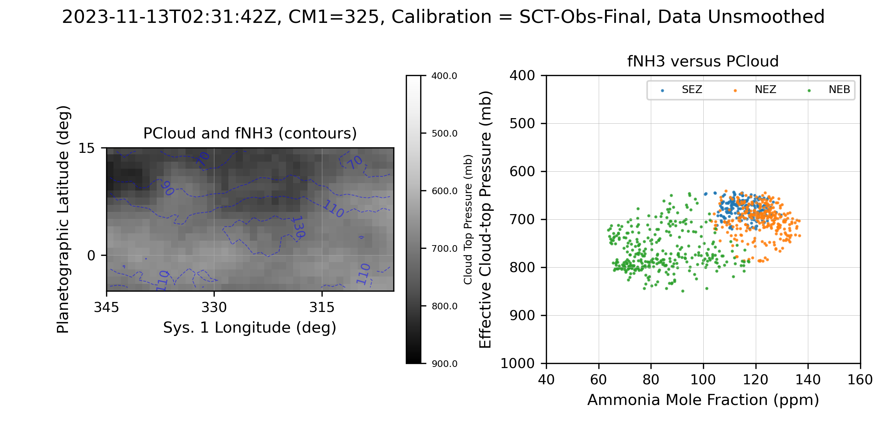
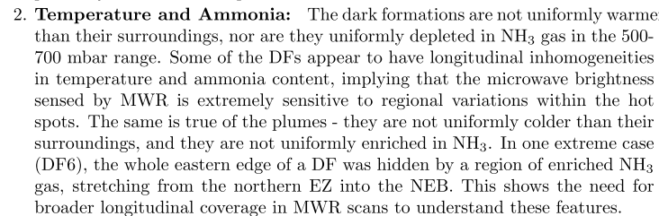
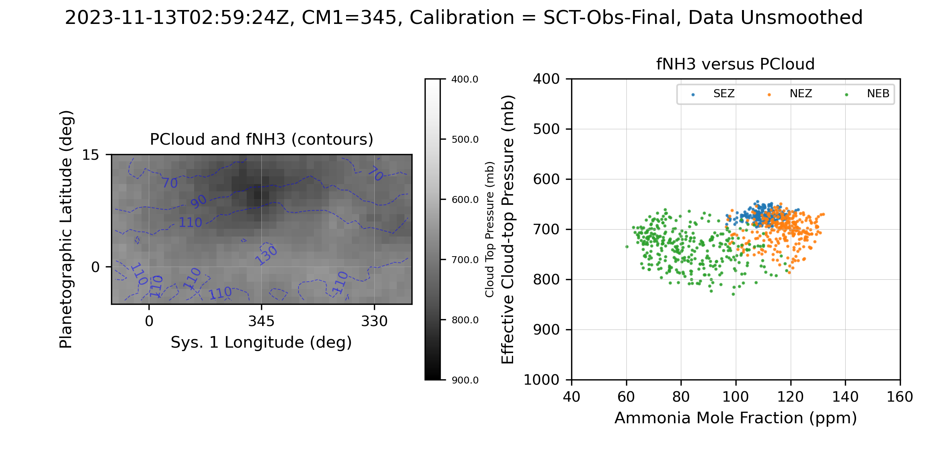
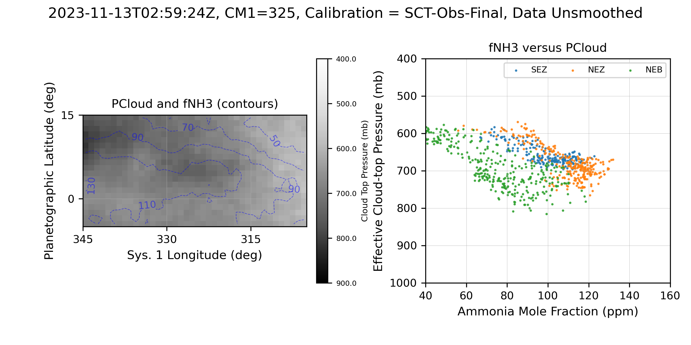
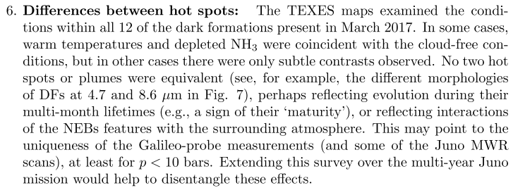
a)
b)
Additional Examples
Spatial resolution is 1-2 arcsec, which translates to about 3-6 deg of latitude.
a-b) show two different regions on different dates
c-d) and e-f) show the same two regions observed 30 mins apart on 2023-11-13. Note that e) was close relatively close to the limb.
Note the variations measured in the MIR showing that ammonia enhancements and depletions are not always directly correlated with hotspots and plumes (Fletcher et al., 2020, excerpts below).
c)
d)
e)
f)

Slide 5
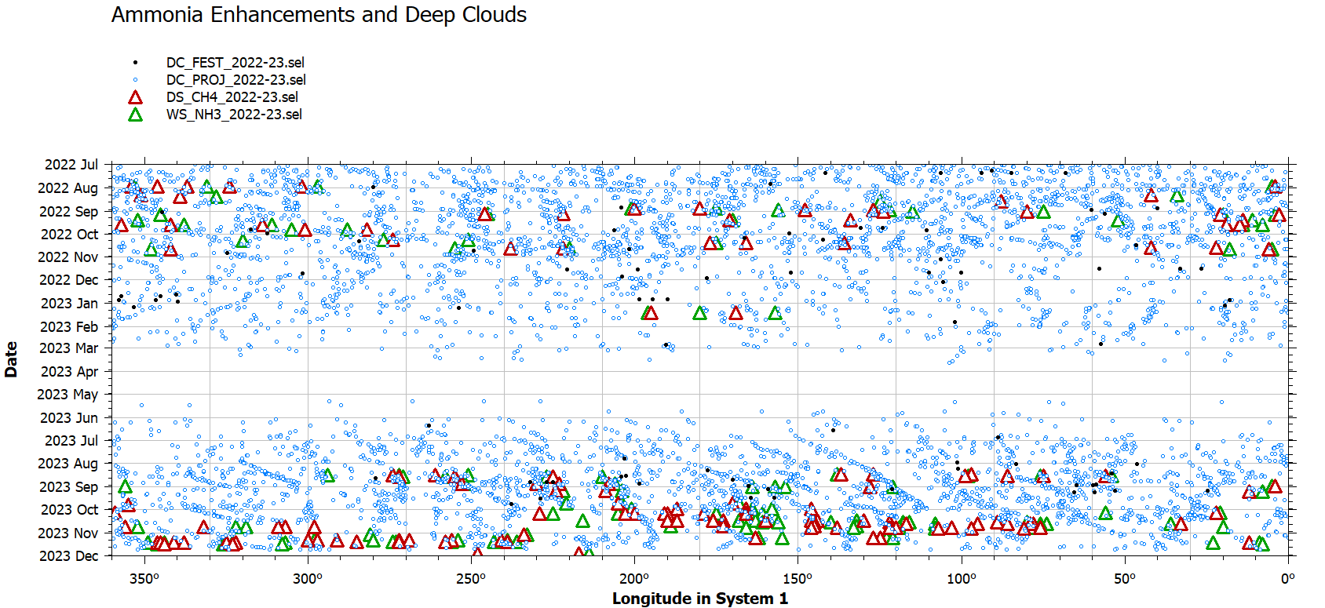
NH₃ and CH₄ Features in Context with WinJUPOS Dark Formations
Centroids of NH₃ enhancements and CH₄ (619nm) deep clouds were measured by visual inspection and entered into WINJupos
Latest release (2023-11-22) of WINJupos measurements of Dark Projections and Festoons

Slide 6
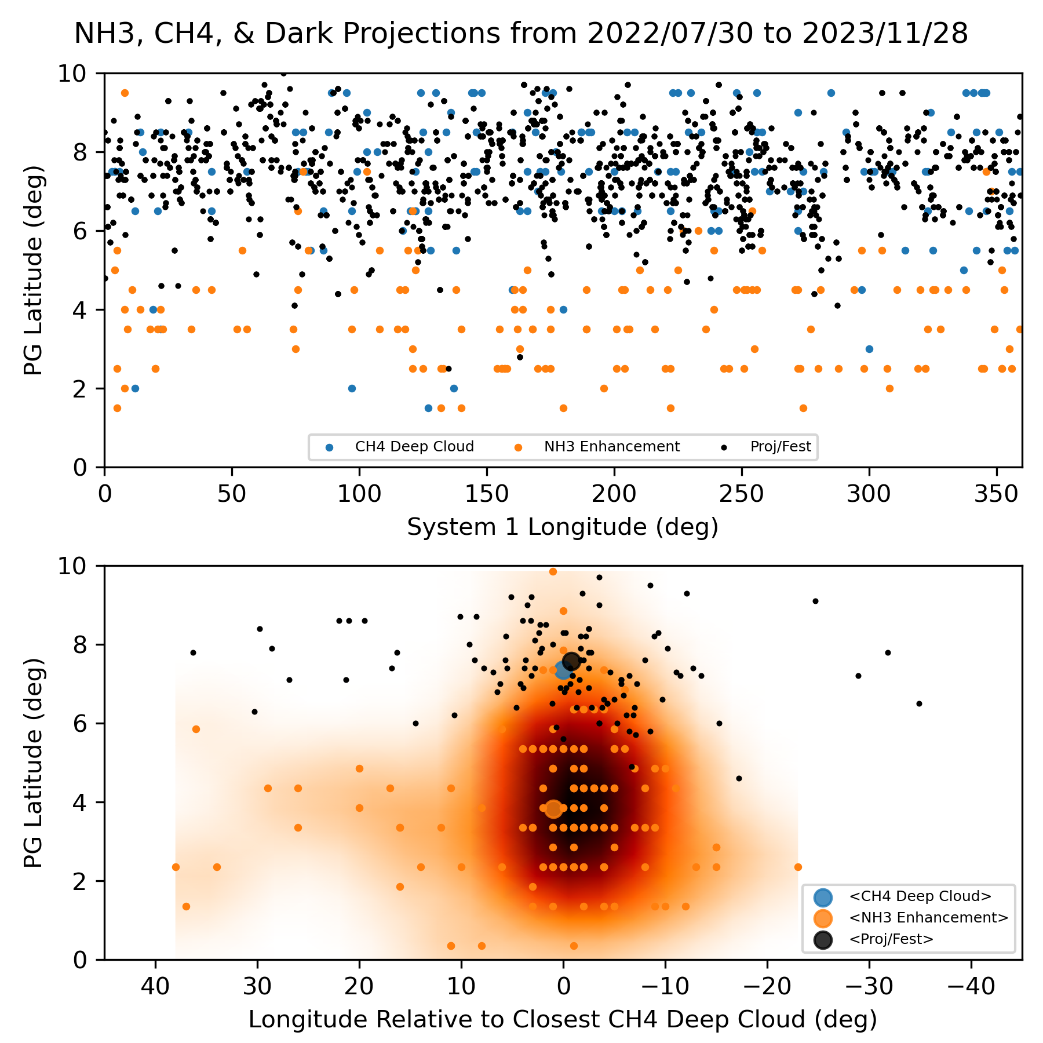
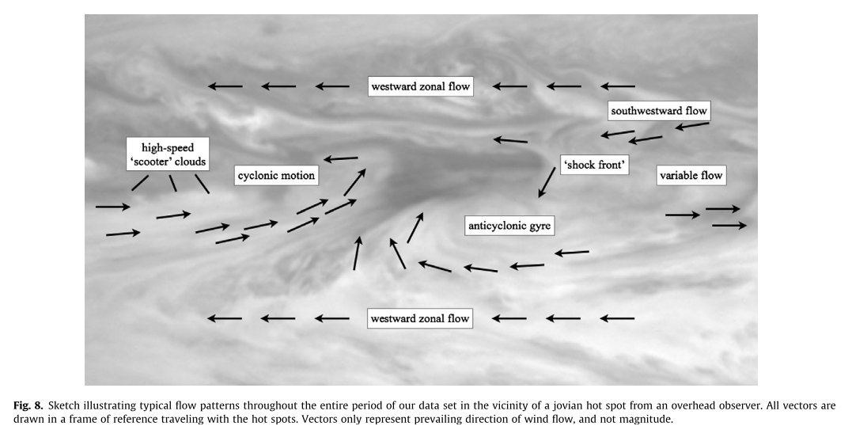
Relative Locations of Deep Clouds, Dark Features, and NH₃ Enhancements
a) NH₃ enhancements, CH₄ deep clouds, and projections/festoons from same UT day are plotted.
b) Same as a), but plotted with longitude relative to closest CH₄ deep cloud and density map of NH₃ relative locations overlaid.
c) Typical flow patterns near around a hot spot (Choi et al., 2013, Fig. 8).
Suggests NH₃ enhancement generally occurs near the anticyclonic gyre and/or westward zonal flow.
a)
c)
b)

